Slide 1
How many words?
Jonathan Doane Binghamton University
Joanne Dong University of Michigan
Team Holst
Project Mentor: Dananjaya Liyanage

Slide 2
“You can’t IMPROVE,
what you don’t record.”
Steve Hannon, PhD
President and CEO
LENA Foundation.

Slide 3

EARLY TALK sparks
brain development
CLOSE the literacy gap
PREPARE children for a successful life

Slide 4

BETTER records
for
BETTER growth

Slide 5
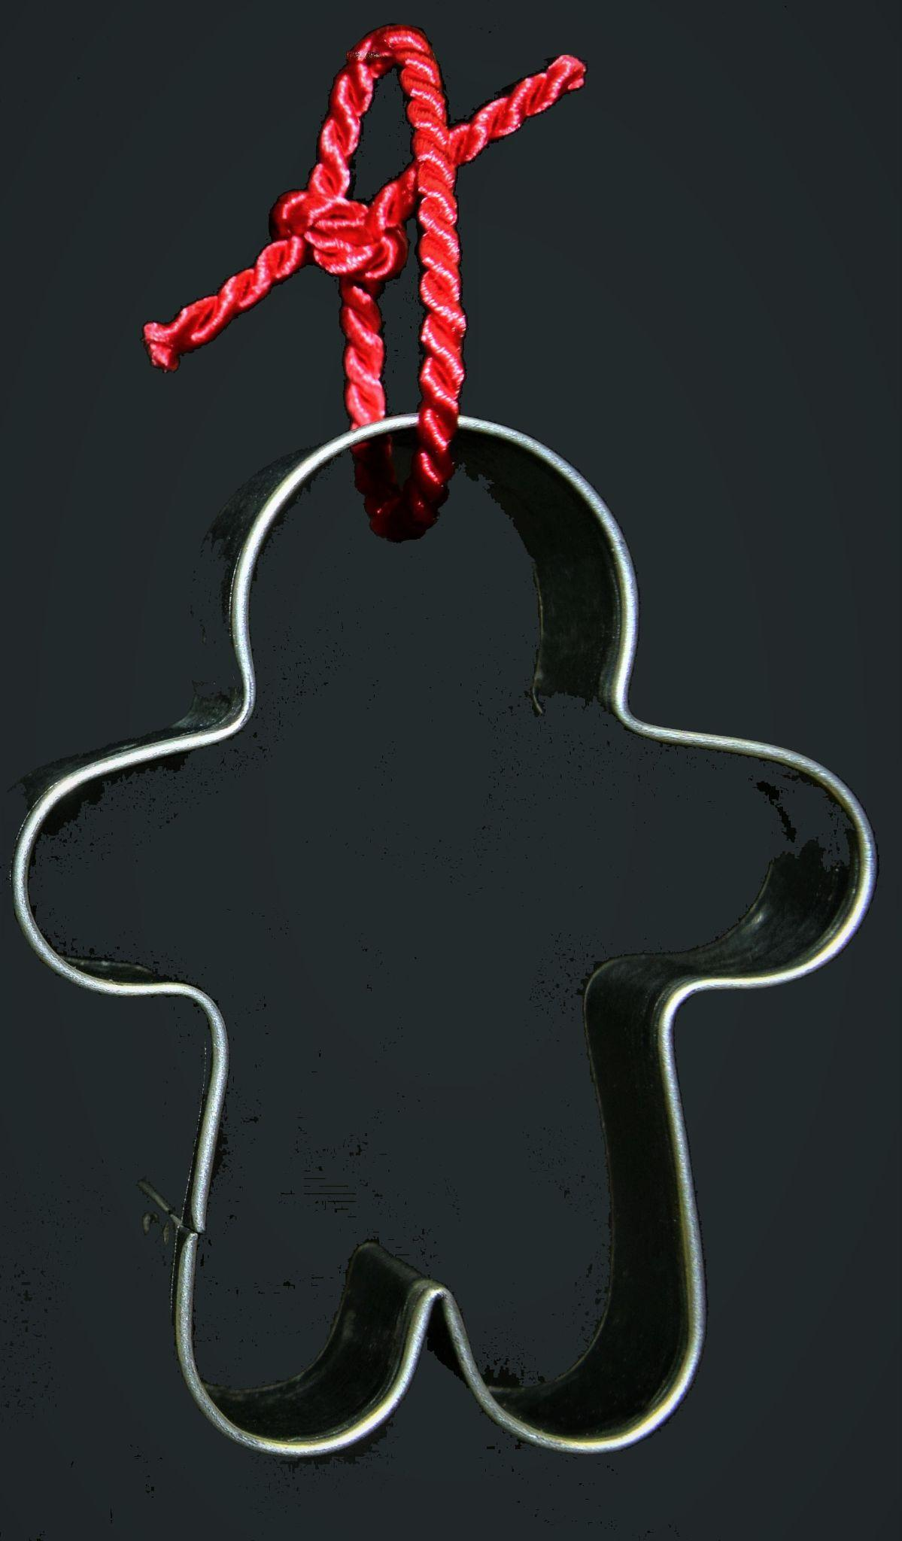
GOAL:
Challenge:
SPEECH
RECORDING
WORD COUNT
DIFFERENT
PERSON
DIFFERENT AUDIO
Notes:
Given audio input of human speech, determine how to count the number of words in the recording accurately based on splitting the audio by silences.

Slide 6
- METHODOLOGY -

Slide 7
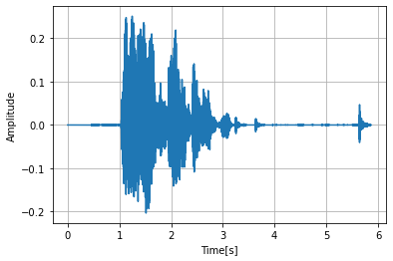

But first … what is a waveform?

Slide 8
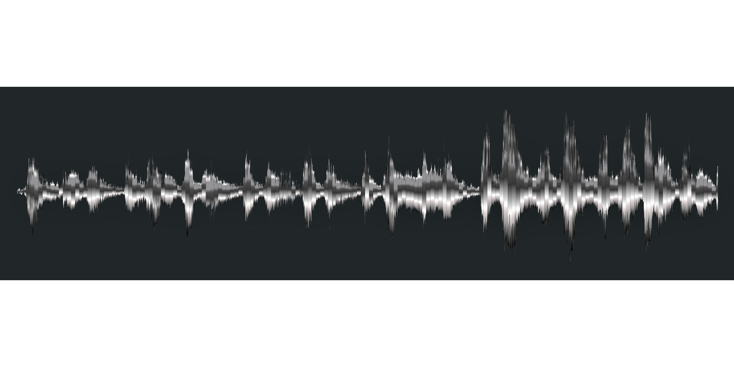

Look for SILENCES
Is this SILENT enough?

Slide 9
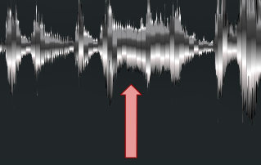


INSENSITIVE analyzer
doesn’t count the
word break
SENSITIVE analyzer
(loud “silence threshold”)
counts the word break

Slide 10
Look for PAUSES
Is this LONG enough?

Slide 11
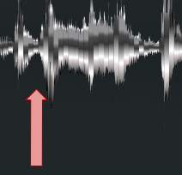
INSENSITIVE analyzer
doesn’t count the
word break
SENSITIVE analyzer
(short “silence length”)
counts the word break

Slide 12

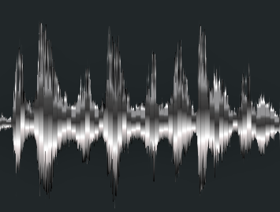
ONE LAST NOTE
NORMALIZE to specified volume

Slide 13
In conclusion…
64 analyzers
are better than 1!
… you’ll see

Slide 14
- Data Collection -

Slide 15
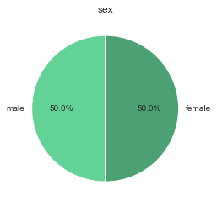
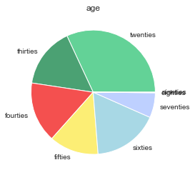
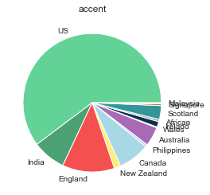
Kaggle: common voice 2:
Training set: 2000 clips
Validation set: 400 clips
Test set: 400 clips

Slide 16
EXPLORATORY DATA ANALYSIS -

Slide 17
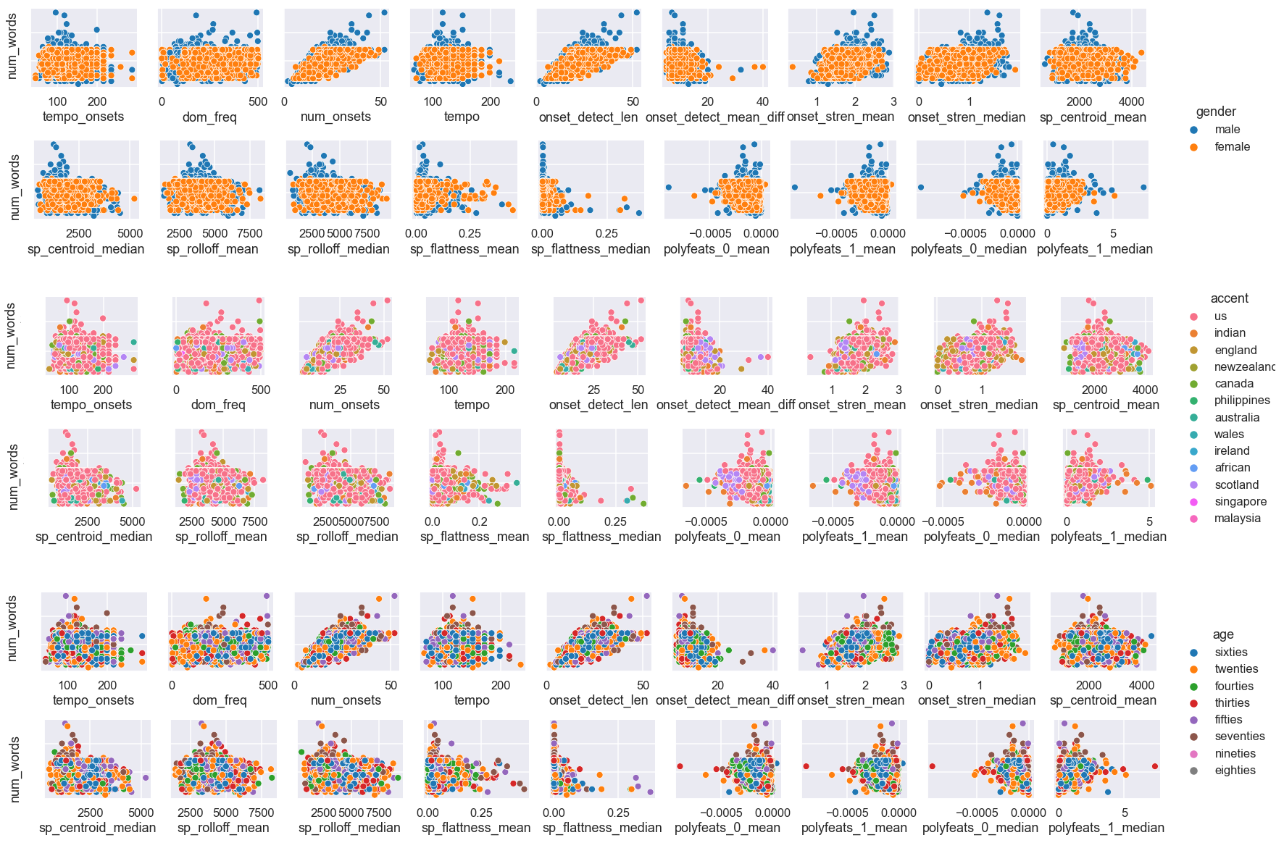

Slide 18
Modeling Approach
input
audio features
optimize
output
.wav file
+
demographic
data
number of onsets
onset strength mean
dominant frequency
+ 15 other audio features…
split on silences
Ideal parameter values and accuracy
minimum silence length
silence threshold
target audio level
Packages:
Audio processing: librosa, pydub
Data processing & visualization : numpy, scipy, pandas, seaborn, matplotlib
Machine learning: sklearn

Slide 19
Certain parameters
yield
SIMILAR functions (analyzers)

Slide 20
Given an audio clip,
we select:
1
suitable analyzer
(of the 64)
… you’ll see

Slide 21
- RESULTS -
(with demographic data)

Slide 22
Predictions with demographic data
Demographic Data:
Sex: Female or Male
Age: Under 50 years or Above 50 Years
Accent: US or non-US
Metric: “offset ratio”:
| 1 - ( # counted ) / ( # actual words) |
minimum silence length
13 ms
16 ms
silence threshold
-4 dbFS
-1 dBFS
target audio level
13 dBFS
16 dBFS

Slide 23
Predictions with demographic data
Validation analysis
Training
set
Training
Set for Group ____
Training set
(80%)
Validation set
(20%)

Slide 24
Predictions with Demographic Data
Results
Conclusion
Group | Avg. offset ratio for training data | Avg. offset ratio for validation data
Sex: male | .47 | .48
Sex: female | .36 | .37
Age: under 50 | .49 | .46
Age: above 50 | .41 | .40
Accent: US | .45 | .42
Accent: non-US | .47 | .47
This approach was not optimal.
It recommended the same set of parameters for all groups:
minimum silence length
13 ms
16 ms
silence threshold
-4 dbFS
-1 dBFS
target audio level
13 dBFS
16 dBFS

Slide 25
- RESULTS -
(without demographic data)

Slide 26
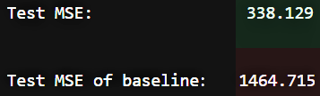
DOUBLED
*
ACCURACY
*

Slide 27
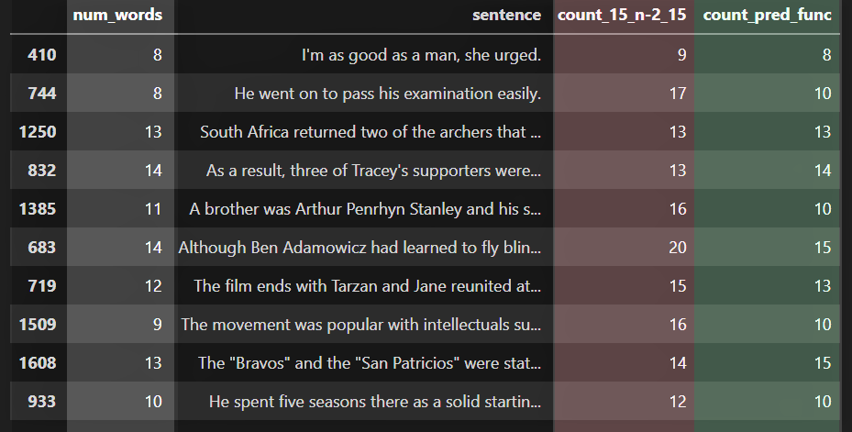
(one analyzer)
(many analyzers)

Slide 28
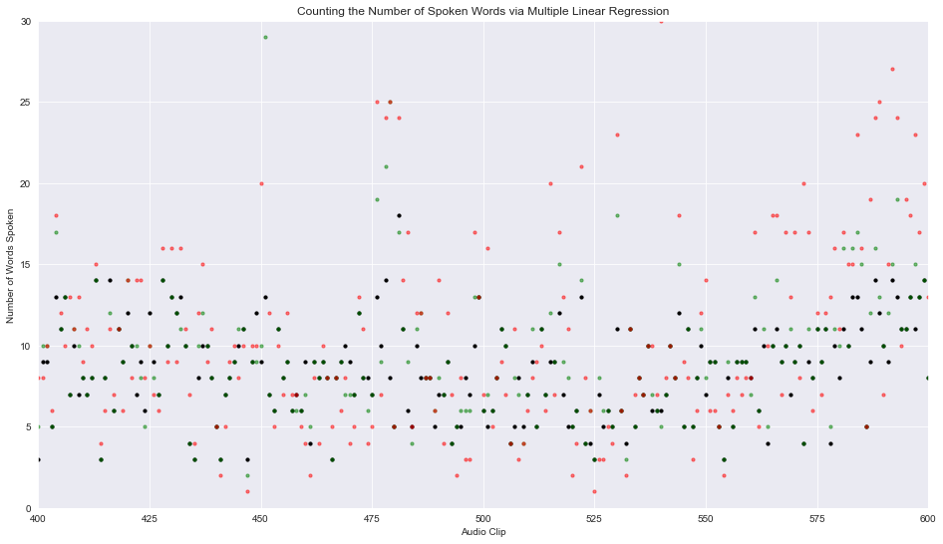
(one analyzer)
(many analyzers)

Slide 29
With LINEAR and
MULTIPLE LINEAR
REGRESSION

Slide 30
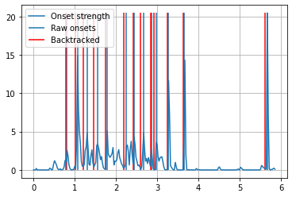
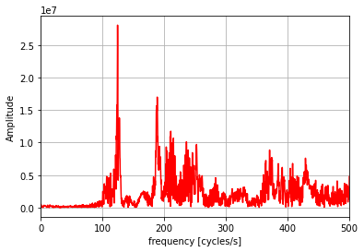

Slide 31
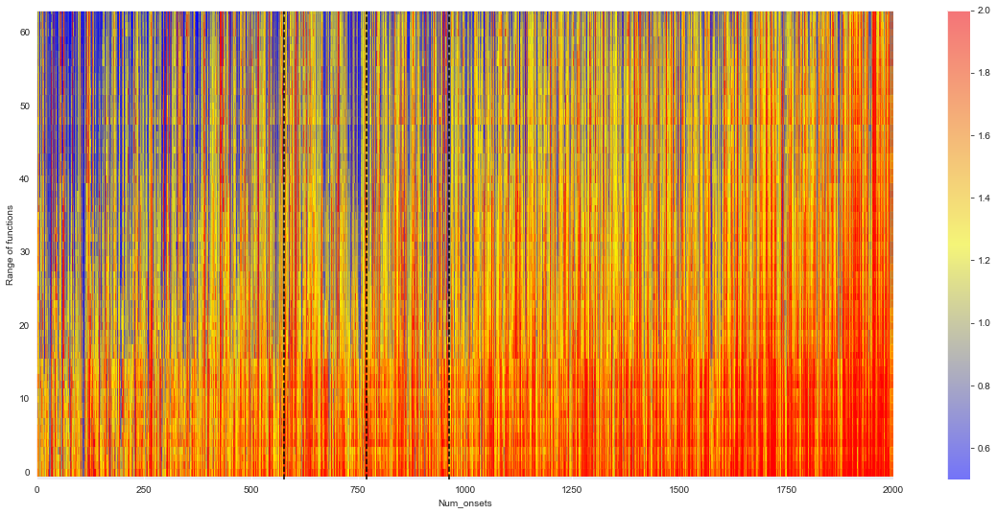

Slide 32
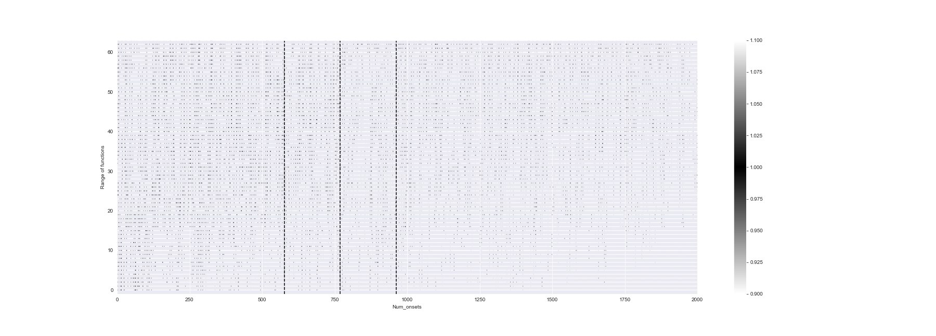

Slide 33
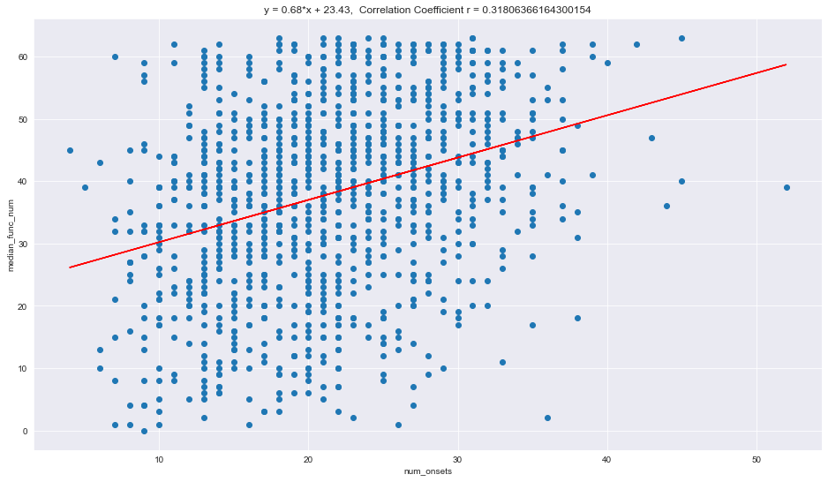

Slide 34
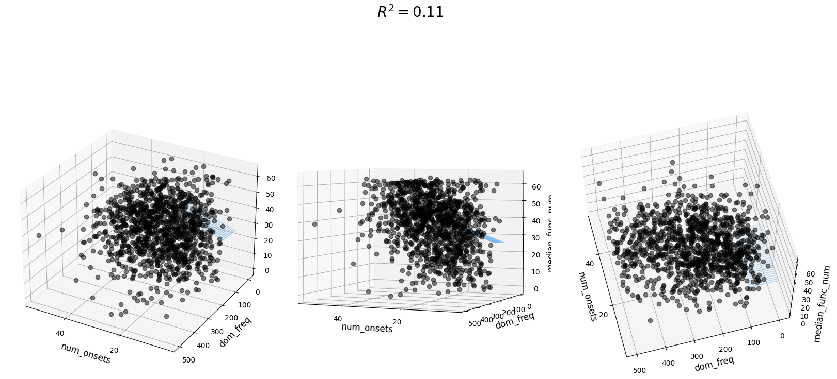

Slide 35
SUCCESSES! … and limitations
Identified most relevant audio features for predicting word count
2 models: predicting based on audio features and demographic information
Same counting function recommended based on demographic information
Combine models: use audio features to predict demographic information
Fine-tune counting functions
Training on a larger data set
Use algorithms on test set

Slide 36
IMPLICATIONS -

Slide 37
BETTER records
for
BETTER growth

Slide 38
EARLY TALK sparks
brain development
CLOSE the literacy gap
PREPARE children for a successful life

