Slide 1
Doggy Doggy What Now?
Using ML to Predict Animal Shelter Movement
John P. Harden Angela Kubena Jun Bo Lau Claire Merriman Robert Young
Notes:
JH Script: According to the Humane Society, approximately 3 million dogs enter Animal Shelters each year, with around 2 million being adopted. Many of those who help these shelter’s function are volunteers who are overwhelmed with a constant stream of dog intakes and outcomes - in other words - movement. How can these shelter workers best anticipate day-to-day movement of dogs in order to best allocate limited resources? My name is John P. Harden, and along with my teammates Angela Kubena, Jun Bo Lau, Claire Merriman, and Robert Young - we will tell you how we used Machine Learning to predict movement within animal shelters. (~est 30 seconds)

Slide 2
Notes:
JH Script: More specifically we asked, if we could build a predictive ML model of total intakes and outcomes using macro-level features. If we could accurately model and predict movement, then animal shelters would have paw up in allocating resources and planning strategically. First, Robert will discuss the limits of national data. Then, Claire and Jun Bo will tell you about our success using Time Series analysis to predict shelter movement, and finally Angela will conclude by discussing opportunities and future directions (~est 25 seconds)

Slide 3
National Data
Notes:
RY Script:
When we initially searched for data, we found a standardized national database run by “Shelter Animals Count” founded by organizations including The Humane Society and the ASPCA.
Despite being well organized and including a lot of data - only 3 years of aggregate data are available as a preview, one must pay $500 for access to the complete dataset, and it takes 2-3 weeks to receive the data.
This data was still useful in looking over important features including the multiple modes for intake (bringing an animal into the shelter) and outcome (how the animal left).*
Given a short turnaround time, we used this as a jump-off point to locate cost-free publicly available datasets from two states with the highest numbers of annual movement as presented here: TX and CA.
(~ 33 secs)

Slide 4
Sonoma County, CA and Austin, TX Data
Notes:
For the time series analysis, we looked at the total intakes and outcomes for Sonama County, CA and Austin, TX from 2014-2024.
We use various baseline models such as naive forecast, linear regression. In particular, this slide contains a plot of the 90-day rolling average model similar to the year-over-year monthly averages we found in some shelter analyses, along with the total intakes for both Austin and Sonoma. In both data sets we can see a dip in March 2020, and the rolling average also allows us to see the lack of expected seasonality.

Slide 5
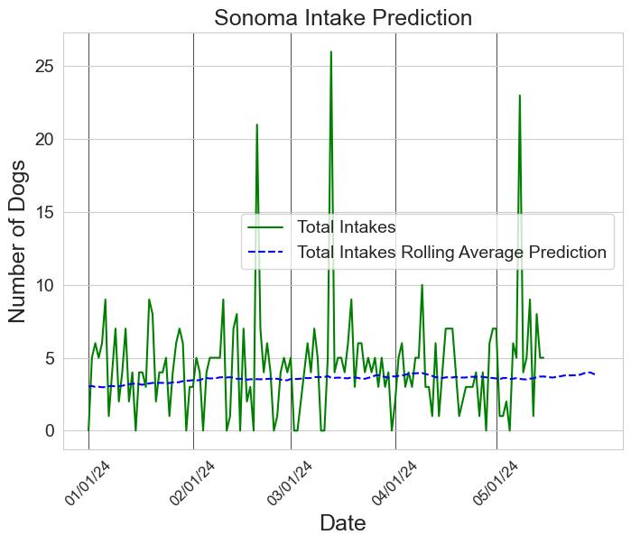
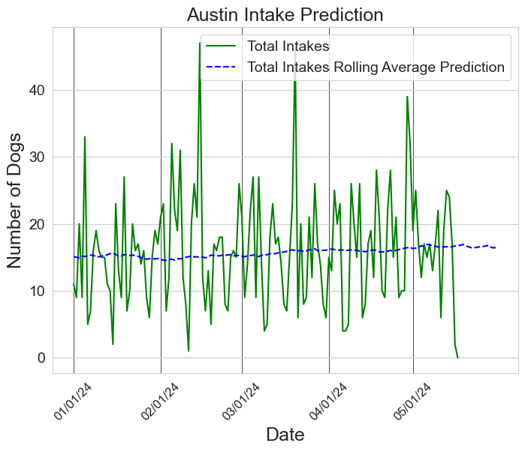
Rolling averages prediction
Notes:
Here we have the 2023 30-day rolling average for total intakes as a prediction for the 2024 numbers. Due to the highly variable data, and the small numbers, especially in Sonoma County, the rolling average is still highly variable. We still believe this could be a helpful model for shelter workers, in addition to our other models.

Slide 6
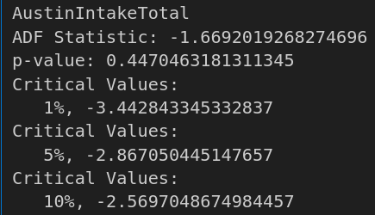
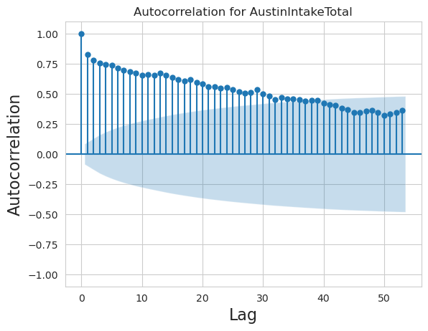
(S)ARIMA?
Unit root, ADF tests
periodogram
Eyeball???
ACF plots
🍖
Notes:
We consider (S)ARIMA to model our time series data. Our choice of hyperparameters were informed by ACF plots, unit root test, periodogram, and Augmented Dickey-Fuller test. Finally, we obtain our parameters using a grid search via auto_arima.
(19 seconds)

Slide 7
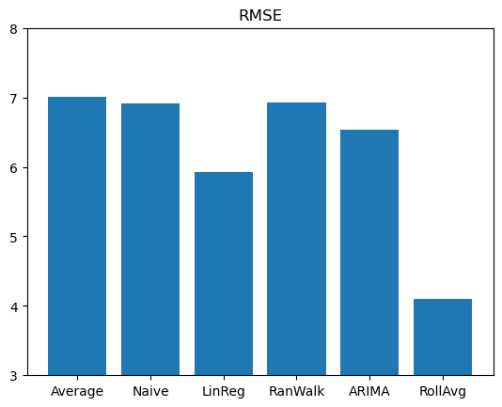
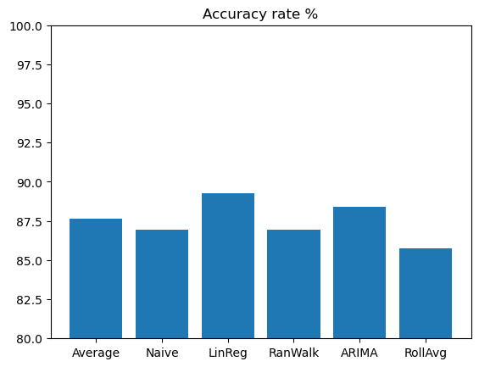
Performance Comparison
 | Daily | Weekly | Monthly
Lowest RMSE | Rolling average | Naive/random walk/ARIMA | Linear regression
Accuracy rate (= 1 - NMRSE) | Linear regression (~90%) | Naive/random walk/ARIMA (~ 90%) | Naive (~92.5%)
Notes:
All of the models achieved at least 85% accuracy, with the baseline models sometimes having better performances than ARIMA. For example, a linear regression forecast is the most accurate for day-to-day prediction. Note that ARIMA and rolling averages model are able to capture the effect of COVID-19 and in order to predict outlier events in the future, it might be helpful to use tools from extreme value analysis.
(28 seconds)

Slide 8
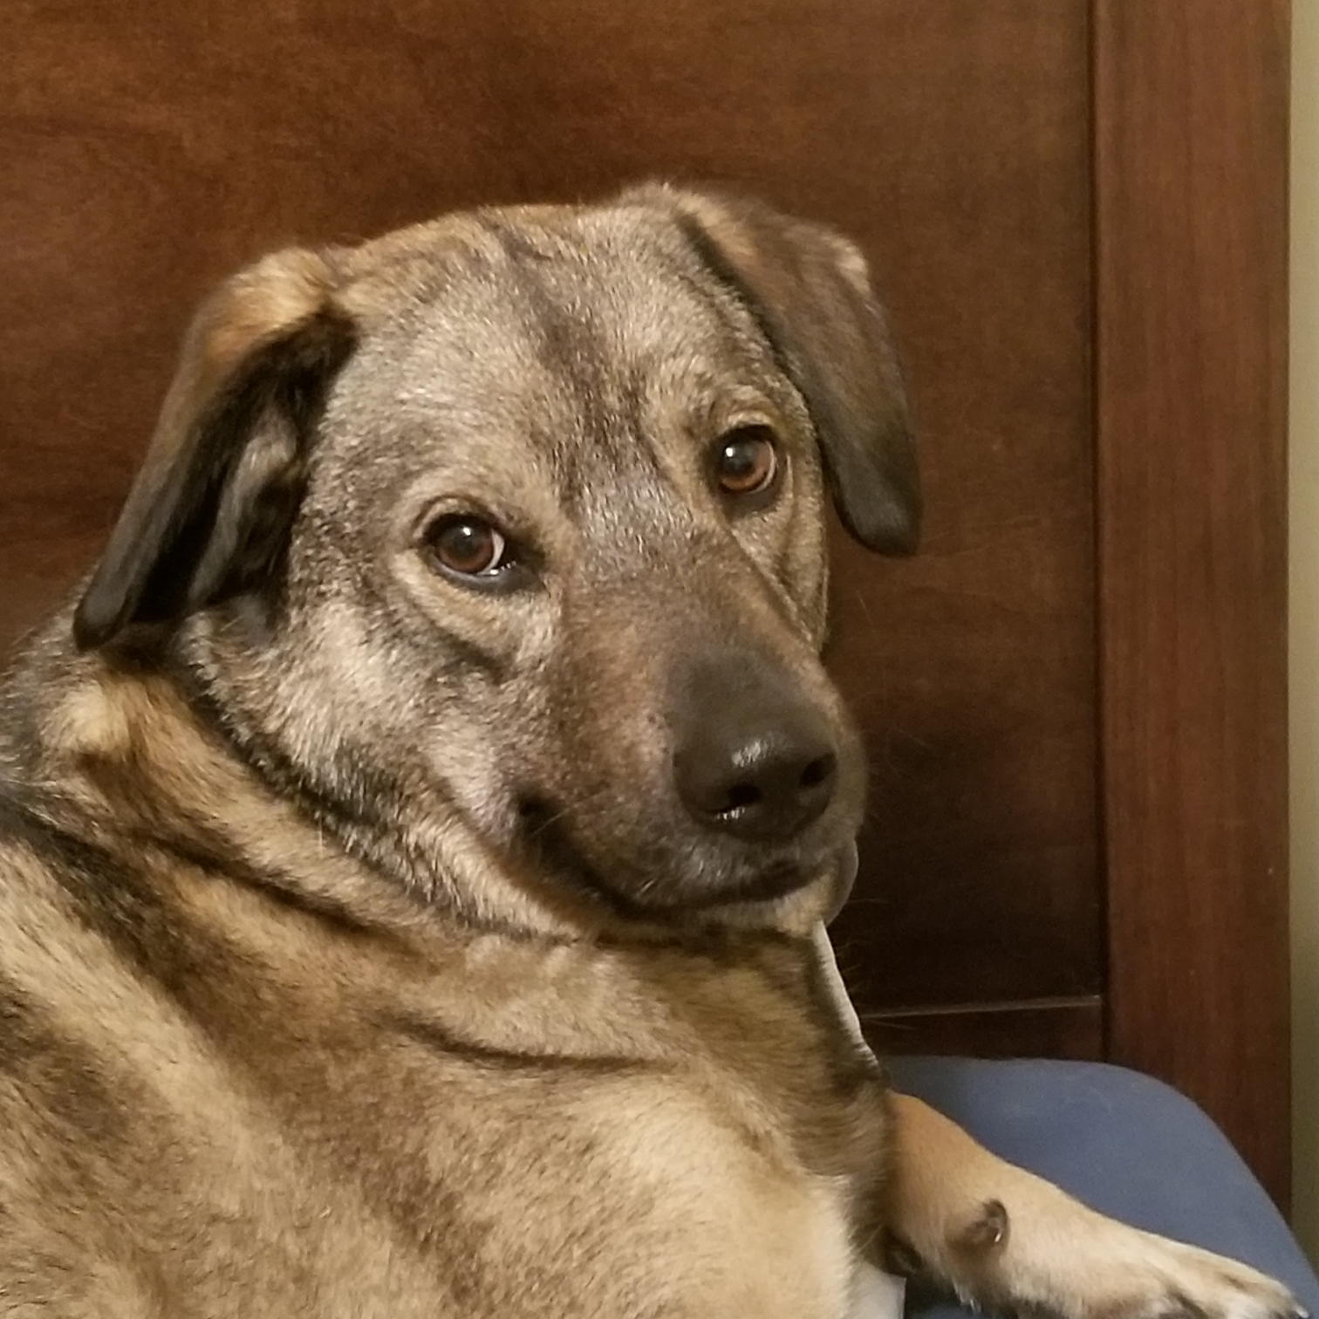
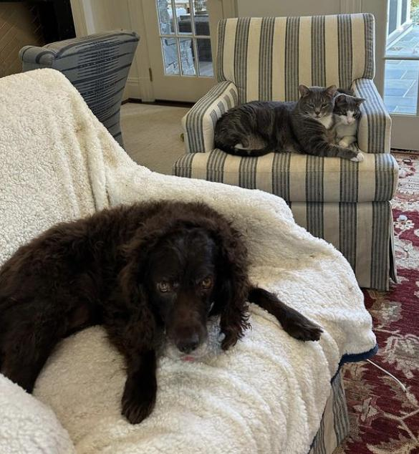
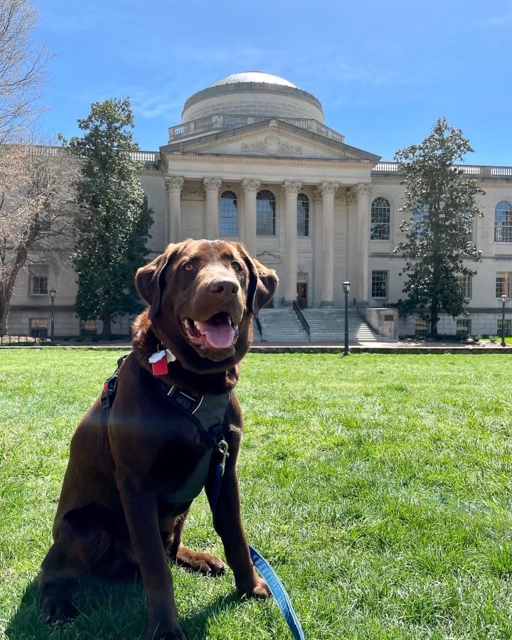
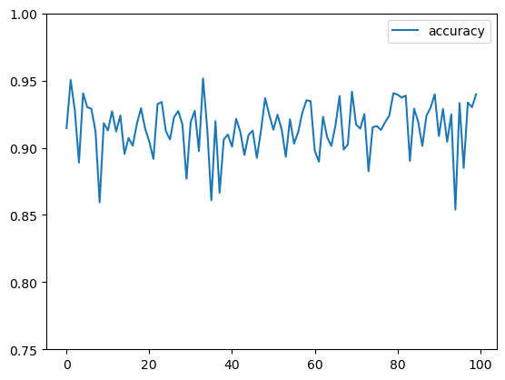
Not the end of the tale/tail… (oof/woof)
Notes:
We were able to successfully leverage Machine Learning to predict Shelter movement with high accuracy.
But there are definitely opportunities for future research.
First, even though we were expecting seasonality, we didn't find it.
The scale of the data was also quite small, especially in Sonoma County, CA.
If animal shelters could agree on a national standard for tracking data, this would be beneficial for analysis, shelter resource management, and inter-state communications regarding transfers.
Our group was able to make additional progress using Random Forests and shelter-level features to predict whether a dog will be adopted.
Future research could continue to leverage those approaches.
Future research could also use deep learning and national data to model state transfers.
Finally, we restricted our analysis to dogs. What about cats?
For additional information, check out our github.
Thank you for your time.

